Slide 1
Digital Portfolio
STUDENT NAME: Santhya.S
REGISTOR NO AND NMID: 222411463 /
4506C1B5966FD1C80D84A7D723E36FFC
DEPARTMENT: BSC .COMPUTER SCIENCE
COLLEGE/UNIVERSITY: Mangalam College of Arts & Science/University of Madras

Slide 2
: Interactive digital portfolio using front end development
PROJECT TITLE:

Slide 3
AGENDA
Problem Statement
Project Overview
End Users
Tools and Technologies
Portfolio design and Layout
Features and Functionality
Results and Screenshots
Conclusion
Github Link

Slide 4
PROBLEM STATEMENT
There’s no efficient way for students to demonstrate technical growth over time. A portfolio site helps track, share, and display progress in one place.

Slide 5
PROJECT OVERVIEW
This project involves the development of a modern and responsive digital portfolio designed to help individuals showcase their academic, professional, and technical achievements. The portfolio includes key sections such as "About Me", "Education", "Skills", "Certificates", and "Contact“ details for easy communication. The main goal is to provide a personalized online space that highlights the user’s strengths and experiences through an interactive and visually appealing interface.

Slide 6
WHO ARE THE END USERS?
•Students (academic projects, resumes).
•Job seekers (to share with recruiters).

Slide 7
TOOLS AND TECHNIQUES
Html
CSS
JavaScript → Interactivity (mobile navigation menu toggle)
Visual Studio Code

Slide 8
PORTFOLIO DESIGN AND LAYOUT
• Home
• About Me
• Skills
• Projects
• Achievements
• Contact
• Responsive navigation with hamburger menu
•Responsive layout (mobile ,desktop view)

Slide 9
FEATURES AND FUNCTIONALITY
• Responsive navigation bar with hamburger menu for mobile view
• Skills section displayed using simple list
•Certificates section displayed in grid format
• Contact details with email,-phone number
• Footer copyright

Slide 10
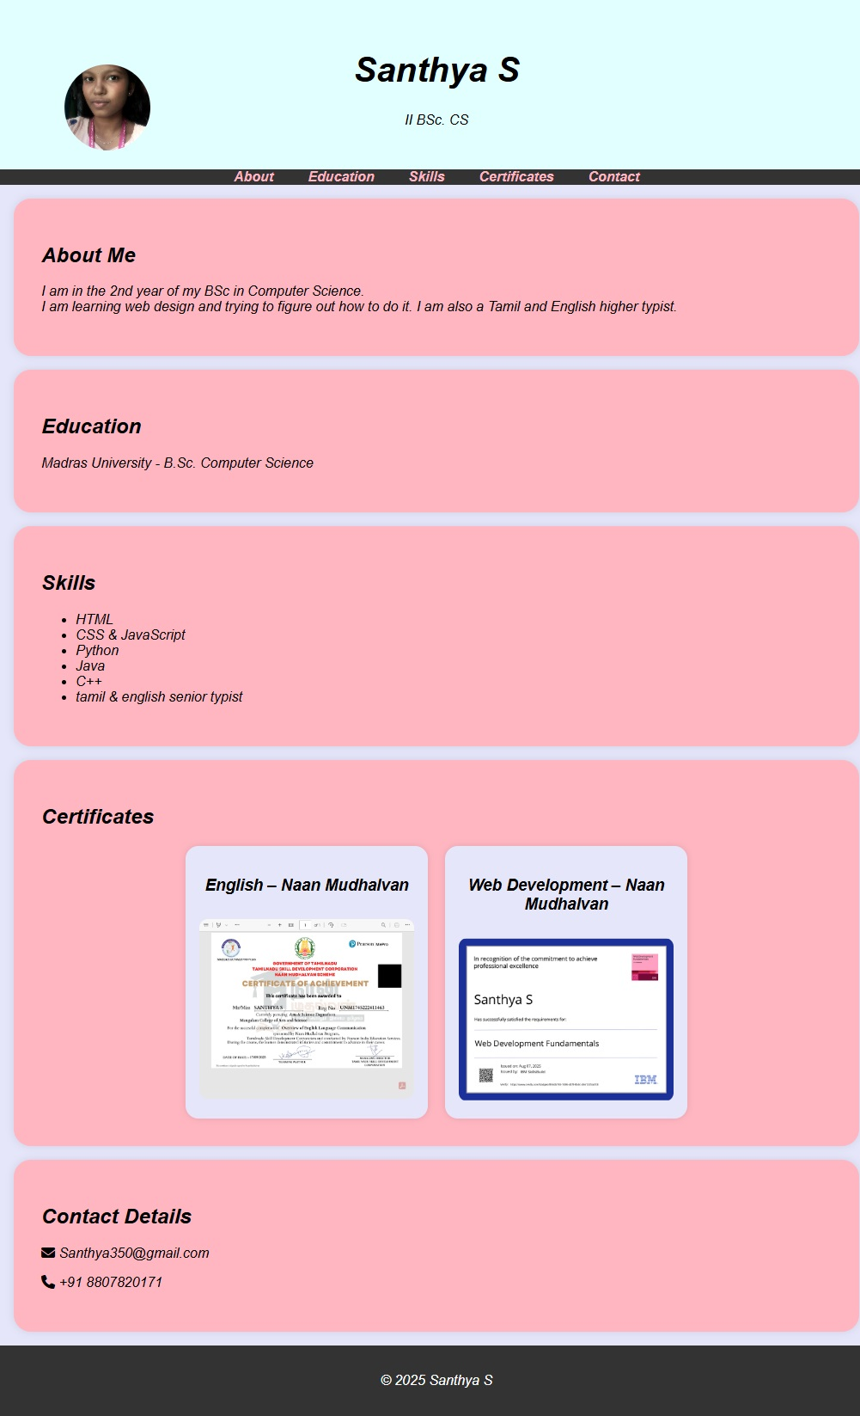
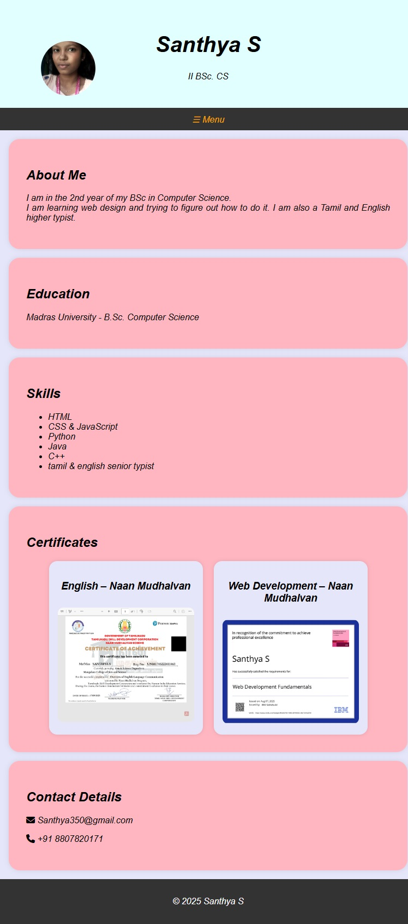
RESULTS AND SCREENSHOTS
Desktop view
Mobile view

Slide 11
CONCLUSION
The portfolio demonstrates how a structured layout can showcase both academic and personal interests. It provides easy navigation, responsive viewing, and a clean user experience.
https://santhya350-star.github.io/S.SANTHYA-1/

